Slide 1
Skin Integrity and Wound Care
Chapter 36

Slide 2
Factors Affecting Skin Integrity
Genetics and heredity
Age
Chronic illnesses and their treatments
Medications
Poor nutrition

Slide 3
Types of Wounds (Tab 36-1;p. 829)
Incision
Contusion
Abrasion
Puncture
Laceration
Penetrating

Slide 4
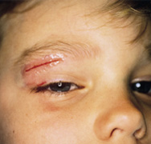
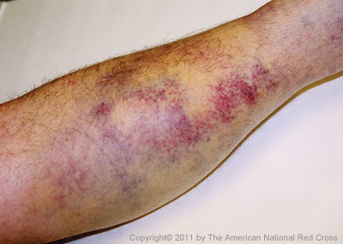
Types of Wounds
Closed
Open
Laceration
Contusion

Slide 5
Incision

Slide 6
Puncture

Slide 7
Depth of Wounds
Partial-thickness wounds
Full-thickness wounds

Slide 8
Etiology of Pressure Ulcers
Caused by deficient blood supply to tissue
First appears pale
Next, reactive hyperthermia
Then, reassess area
Did reactive hyperthermia disappear?
Does the area blanch?

Slide 9
Risk Factors for Pressure Ulcers
Friction and shearing
Immobility
Inadequate nutrition
Fecal and urinary incontinence
Decreased mental status
Diminished sensation
Excessive body heat

Slide 10
Risk Factors for Pressure Ulcers
Advanced age
Presence of certain chronic conditions
Other factors
Poor lifting and transferring techniques
Incorrect positioning
Hard support surfaces
Incorrect application of pressure-relieving devices

Slide 11
Risk Assessment Tools
Braden Scale for Predicting Pressure Sore Risk
Norton’s Pressure Area Risk Assessment Form Scale

Slide 12
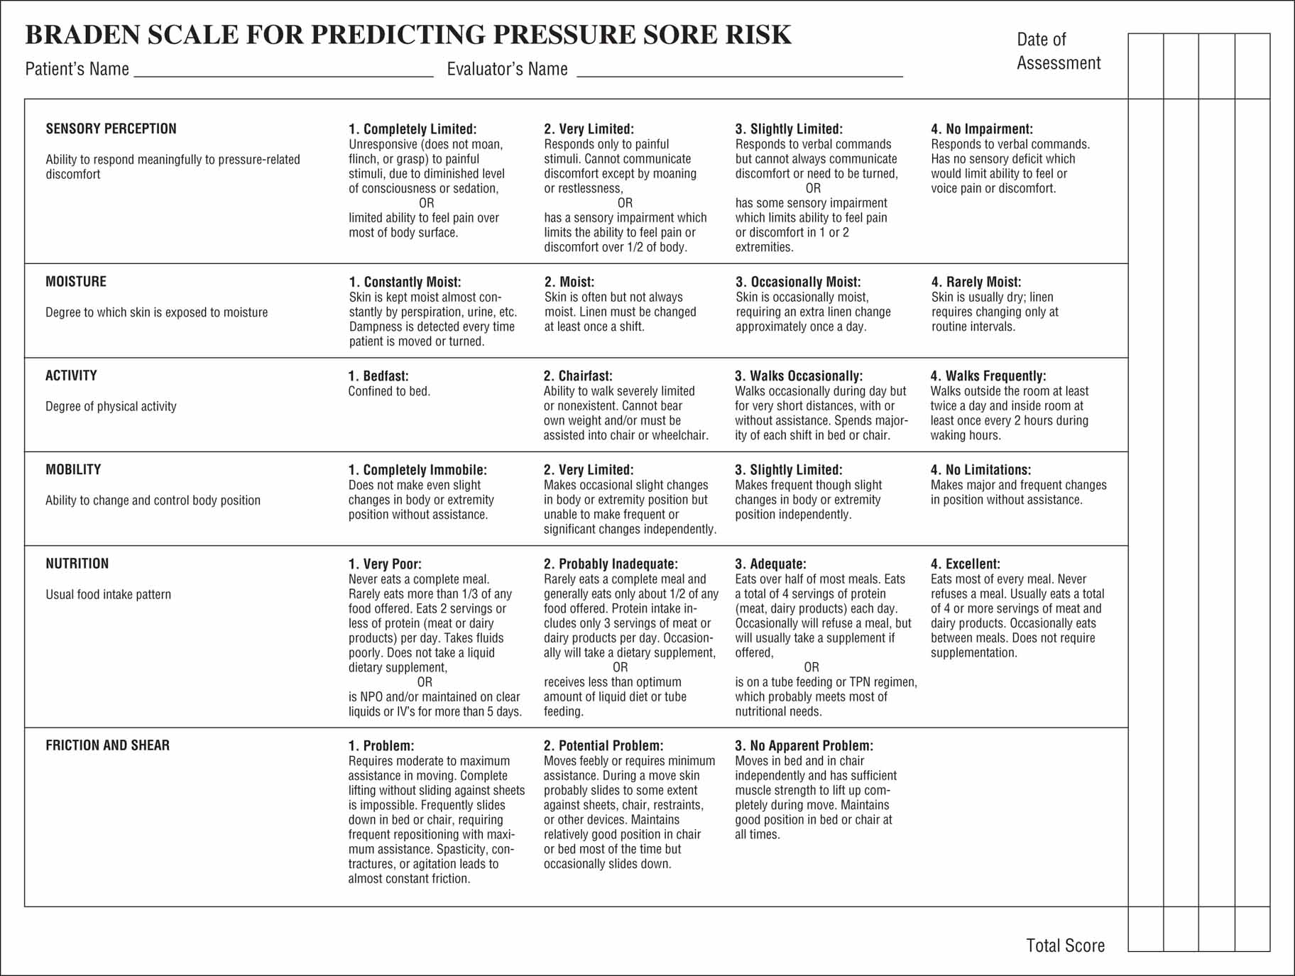
Figure 36-2 Braden scale for predicting pressure sore risk. Copyright © Barbara Braden and Nancy Bergstrom, 1988. Reprinted with permission.
Notes:
12

Slide 13
Table 36-2 Norton’s Pressure Area Risk Assessment Form (Scoring System)
Notes:
13

Slide 14
Staging of Pressure Ulcers
Stage I
Stage II
Stage III
Stage IV
Eschar
Fig. 36-1 pg. 831

Slide 15
Stage 1 Pressure Ulcer

Slide 16
Stage 2 Pressure Ulcer

Slide 17
Stage 3 Pressure Ulcer

Slide 18
Stage 3 Pressure Ulcer

Slide 19
Stage 4 Pressure Ulcer

Slide 20
Types of Healing
Regeneration
Primary intention
Secondary intention
Tertiary intention

Slide 22
Phases of Healing
The inflammatory phase
The proliferative phase
The maturation phase

Slide 23
The Inflammatory Phase
Cleansing phase
Homeostasis
Inflammation

Slide 24
The Proliferative Phase
Granulation tissue
Cell development

Slide 25
The Maturation Phase
Epitheliazation
Remodeling

Slide 26
Wound Exudate
Serous
Sanguineous
Serosanguineous
Purulent
Purosanguineous

Slide 27
Wound Complications
Hemorrhage
Infection
Dehiscence

Slide 28
Factors Affecting Wound Healing
Age
Nutritional status
Lifestyle
Medications

Slide 29
Nursing Process: Assessment (pg. 842)
Nursing history
Skin assessment
Untreated wounds
Treated wounds (also pg. 853)
Pressure ulcers

Slide 30
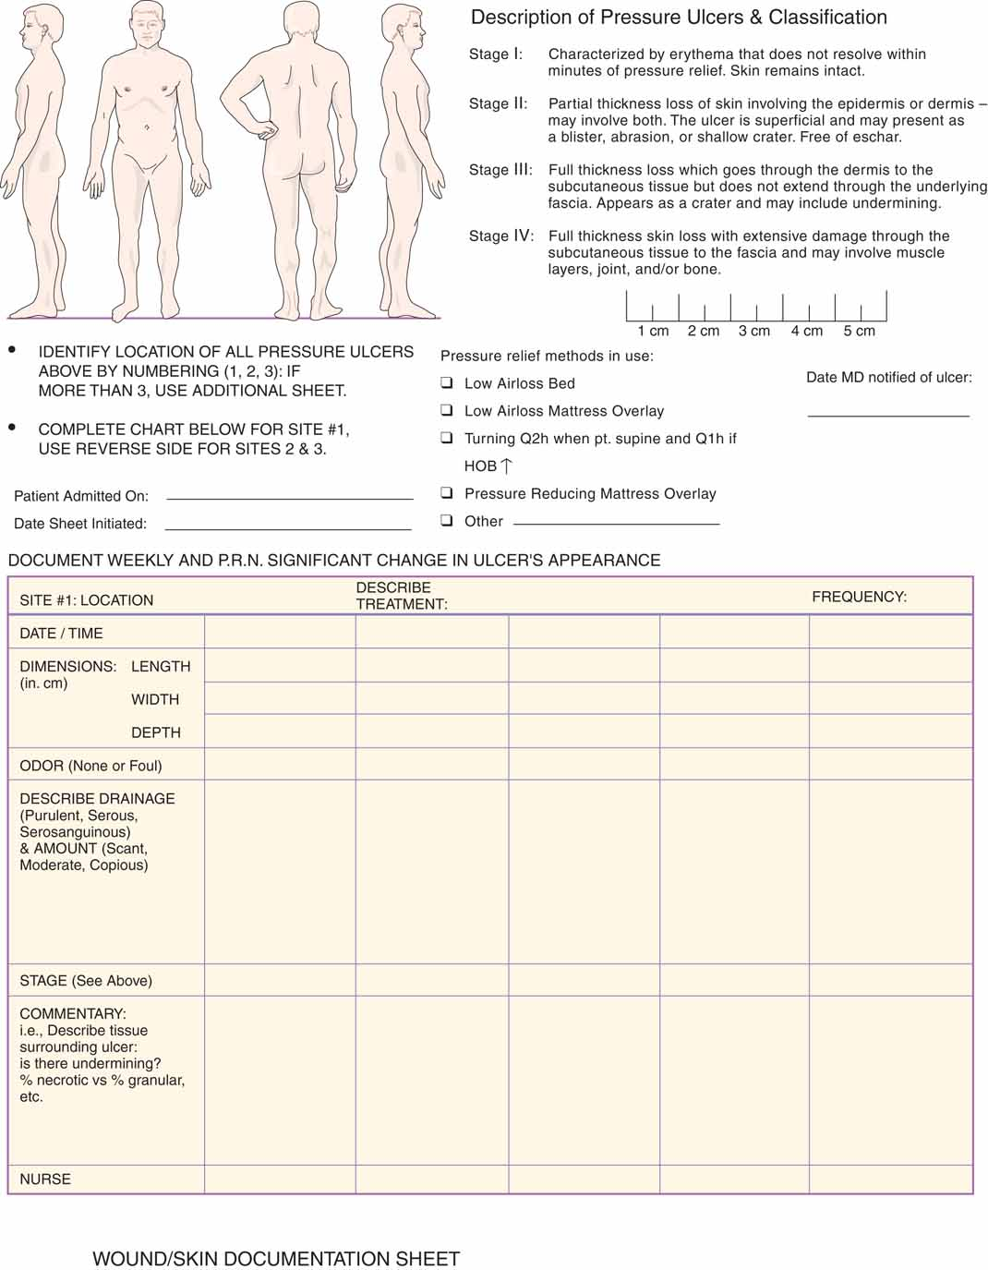
Figure 36-6 Wound/skin documentation sheet.
Notes:
30

Slide 31
Nursing Process: Assessment
Labs
Leukocytes (WBC)
Hemoglobin (Hgb)
Coagulation studies
Protein
Culture & sensitivity (C&S)

Slide 32
Nursing Diagnoses
What nursing diagnoses are relevant to skin integrity?
Risk for Impaired Skin Integrity
Impaired Skin Integrity
Impaired Tissue Integrity
Risk for Infection
Acute Pain

Slide 33
Nursing Process
Impaired skin integrity
Wound will heal by June 1, 2013 AEB:
Decreased in size of wound
No purulent drainage
No erythema
No odor

Slide 34
Nursing Process
Risk for impaired skin integrity
Will maintain intact skin throughout hospital stay AEB:
No breaks in skin
Skin without erythema

Slide 35
Implementing- Supporting Wound Healing
Moist wound
Nutrition/hydration
Preventing infection
Positioning

Slide 36
Implementing- Preventing Pressure Sores
Daily assessment
Nutrition
Skin hygiene
Avoiding skin trauma
Supportive devices

Slide 37
Treating Pressure Ulcers
Minimize direct pressure
Reposition the client at least every 2 hours
Schedule and record position changes
Use of devices to minimize pressure areas
Dressing changes as ordered
Obtain C&S, if infected
Teach the client to move frequently
Provide ROM exercise

Slide 38
Wound Irrigation & Cleansing Wounds
Per clinical learning lab
Pg. 849-851

Slide 39
Binders & Bandages
Per clinical learning lab
Pg. 854-856

Slide 40
Local Effects of Heat
Vasodilation
Increases capillary permeability
Increases cellular metabolism
Increases inflammation
Sedative effect
What are the systemic effects of heat?

Slide 41
Local Effects of Cold
Vasoconstriction
Decreases capillary permeability
Decreases cellular metabolism
Slows bacterial growth
Decreases inflammation
Local anesthetic effect
What are the systemic effects of cold?

Slide 42
Indications
Cold
Heat
Moist or dry

Slide 43
Thermal Applications Considerations
Rebound phenomenon
Age..the very young or very old
Sensory impairment
Impaired mental status
Body part
Amount of surface area
Injury or surgery

Slide 44
Group Work
Critical Thinking Checkpoint pg. 862

