Slide 1
BUDDHISM
BY Jennifer Franks, June Arthur, Kiosha Lawrence, & Annette Acevedo Bernal

Slide 2
Skandhas or five aspects of being
Buddha taught that we as humans are made up of five skandhas, or in English, five aspects of being.
To Westernize these, we linked them to our idea of 'self'
our physical form
our feelings
our thoughts
our habits and
our consciousness of the world around us.
(Whittemore, 2013)

Slide 3
Three Characteristics of Buddhism
dukkha
anicca
anatta
Suffering : an extremely important concept in Buddhism, it’s the belief that all things which have not attained Nirvana are imperfect and flawed.
Impermanence : This is the belief that all of us are in a continual state of change and flux.
Egolessness : the belief that we as humans are not autonomous or sovereign. In short, we're just the by-product of the imperfect whole. (Whittemore, 2013)

Slide 4
Five Precepts serve as voluntary guidelines for life and are the bases of Buddhist morality and are Buddhism's belief of non-violence and ethical living, which should guide human existence. They include an individual’s choice or willingness to be:
1-Aware of the suffering caused by violence: I undertake the training to refrain from killing or committing violence toward living beings. I will attempt to treat all beings with compassion and loving kindness
. 2-Aware of the suffering caused by theft: I undertake the training to refrain from stealing — to refrain from taking what is not freely given. I will attempt to practice generosity and will be mindful about how to use the world’s resources.
3-Aware of the suffering caused by sexual misconduct: I undertake the training to refrain from using sexual behavior in ways that are harmful to myself and to others. I will attempt to express my sexuality in ways that are beneficial and bring joy.
4-Aware of the suffering caused by harmful speech: I undertake the training to refrain from lying, from harsh speech, from idle speech or gossip. I will attempt to speak and write in ways that are both truthful and appropriate.
5-Aware of the suffering caused by alcohol and drugs: I undertake the training to refrain from misusing intoxicants that dull and confuse the mind. I will attempt to cultivate a clear mind and an open heart. Although there is no general consensus with regard to sexual orientation within Buddhism, overall the third precept is most often referenced when discussing gay, lesbian, bisexual and transgender issues.
(Whittemore, 2013)

Slide 5
Buddhism and Homosexuality
Theravada, the oldest form of Buddhism that emphasizes the monastic life
Mahayana Buddhism, a later form that includes Pure Land, Zen, Nichiren
Vajrayana, a unique form that arose in India and Tibet and is led by the Dalai Lama
Monks, live lives of celibacy
- sacred texts do contain a great deal of instances of loving relationships between unmarried men, which some believe to have homoerotic overtones. No sexual contact is mentioned in these instances, however.
Lay Buddhists - are expected to adhere to Five Precepts, the third of which is a vow "not to engage in sexual misconduct.“
interpreted to include actions like coercive sex, sexual harassment, child molestation and adultery. As Homosexuality is not explicitly mentioned
does not make a distinction between same-sex and opposite-sex relationships.
Instead, the expectation is not to harm, exploit or manipulate others, which would directly violate the third precept.
all forms of sex other than penile-vaginal sex are prohibited for Buddhists
-"From a Buddhist point of view, [gay sex] is generally considered sexual misconduct." But the Dalai Lama did note that this rule is for Buddhists, and from society's viewpoint, homosexual relationships can be "of mutual benefit, enjoyable, and harmless."
-opposes violence and discrimination based on sexual orientation. He urges respect, tolerance, compassion, and the full recognition of human rights for all.“
(Buddhism and Homosexuality, 2015)

Slide 6
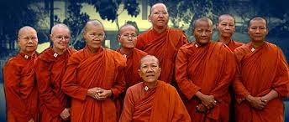
Gender Roles
Gender roles amongst the Buddhist community
Buddhism teaches that men and women are of equal value and men are to respect their wives as friends and partners, not slaves. Household duties are split equally among the men and women with equal dedication. Women are taught to manage the mans affairs and even acquaint herself with the business or industries that the husband is engaged in.
(Buddhist Studies, n.d)

Slide 7
Internal & External Discriminatory Conflicts in Buddhism
http://usatoday30.usatoday.com/news/world/story/2012-04-02/tibet-immolations/53952746/1
http://www.breitbart.com/national-security/2015/05/31/buddhists-turn-violent-in-struggle-against-muslims-in-sri-lanka/
Tibetan protesters have burned themselves in marketplaces, main streets, military camps and other symbols of government authority Sometimes drinking kerosene to make the flames explode from within in western China. The Tibetan self-immolations have so far failed to prompt the changes the protesters demand: an end to government interference in their religion and a return of the exiled Dalai Lama. This form of protest was one of the biggest waves of political self-immolations in recent history.
Buddhist monks accused of stirring up hostility towards other faiths and ethnic minorities in Sri Lanka. Many Buddhist's believe the country was destroyed by the British colonialists, and its current problems are also the work of white people and Muslims. The Buddhist are willing to fight until the country is returned to the original civilization of the Sinhalese.

Slide 8
Buddhism & Discrimination
The Buddha was born into a humanity that used the caste system. For Buddhists, the caste system is an exemplification of discrimination and is something that they do not support. Buddhists teach that prejudice is a case of ignorance. Furthermore, believing that we are in some way superior to those around us is an example of "craving" or of fear.
When people discriminate, their behavior reflects an ignorant attitude towards others. Buddhists believe that ignorance and craving cause pain and people to suffer – known as dukkha.
Buddhists believe in equanimity, upekkha. Upekkha is to maintain a similar attitude towards everyone. Buddhists try to ensure equal respect to all in society.
Buddhists believe that there are no differences between any human. Every individual should be valued and should be treated fair and with justness.
Mahayana Buddhists believe we all have 'Buddha Nature,' i.e., the ability to reach enlightenment. It doesn't matter about our culture, race or background. Once understanding is achieved, there are no divisions at all.

Slide 9
Buddhism & Discrimination
Buddhism is known as the religion uncorrupted by ‘religiousness’ (dogmatism, violence, fundamentalism)(Fuller,2014).
It is the religion of choice for the compassionate individual. Many hold Buddhism in high regards because carnage, war, and hostility have been committed by everyone — except the Buddhist. So the recent acts of the Buddhists against Muslims are not considered true Buddhists.

Slide 10
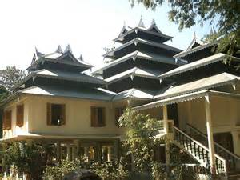
Current Events
Buddhist Monk Is Slaughtered at Temple
On May 14, 2016, a Buddhist monk was found murdered in his temple by his daughter. The event took place in Bangladesh, and appears to be the result of Islamist extremists. During the past two years many killings of religious minorities have taken place in Bangladesh, and many of the attacks were carried out by groups of men using machetes (New York Times, 2016.)

Slide 11
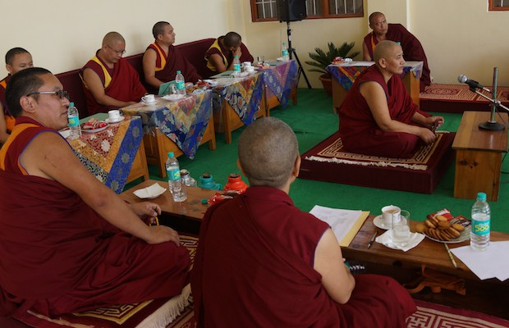
Current Events
Twenty Tibetan Buddhist nuns are first ever to earn Geshema degress.
On July 15, 2016, twenty Buddhist nuns are the first to earn a Geshema degree, which is the equivalent to a Doctorate in Buddhist Philosophy. It represents the highest level of training offered in the Gelugpa school of Tibetan Buddhism. This degree was previously only available to men. This degree will make the nuns eligible to assume leadership roles, that were previously reserved for men.
The Geshema examination process takes a total of 4 years, and a 12-day exam period, which consisted of both oral debate and written exams (Lion’s Roar, 2016.)

Slide 12
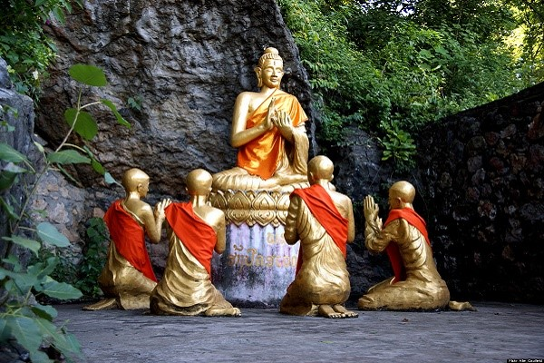
Current Events
Dharma Day Celebrates the Beginning of Buddhism
Dharma Day commemorates the day when Buddha made his first sermon or religious teachings after his enlightenment. The festivity falls on the full moon of the eight month of the lunar calendar. This year that falls on July 19. Buddha happened to be a wealthy prince by the name Siddhartha Gautama. He decided to leave his position and wealth after experiencing the world outside his palace. During Dharma Day, Buddhists visit temples to pray, meditate and listen to sermons. (World Religion News, 2016.)

Slide 13
References
Buddhism and Homosexuality.” ReligionFacts.com. 10 Nov. 2015. Retrieved 3 Aug. 2016
from http://www.religionfacts.com/homosexuality/Buddhism
Buddhist Studies: Buddhism & Women: Position of Women. (n.d.). Retrieved August 03, 2016,
from http://www.buddhanet.net/e-learning/history/position.htm
Colonel Henry S. Olcott | Paul Fuller: Buddhist Studies. (n.d.). Retrieved
from https://drpaulfuller.wordpress.com/category/colonel-henry-s-olcott/
Clobert, M., Saroglou, V., & Hwang, K. K. (2015). Buddhist concepts as implicitly reducing prejudice and
increasing prosociality. Personality and Social Psychology Bulletin, 0146167215571094.
Hardy, J., (n.d.). Buddhism. Gender and sexuality. Retrieved from
http://www.patheos.com/Library/Buddhism/Ethics-Morality-Community/Gender-and-Sexuality
Manik, J. A., & Najar, N. (2016, May 14). Buddhist Monk Is Slaughtered at Temple in Bangladesh. Retrieved
August 6, 2016, from http://www.nytimes.com/
Sperry, R. M. (2016, July 15). Twenty Tibetan Buddhist nuns are first ever to earn Geshema degrees.
Retrieved August 06, 2016, from http://www.lionsroar.com

Slide 14
References
Tibetans set themselves on fire in protest ? USATODAY.com. (2012). Retrieved
from http://usatoday30.usatoday.com/news/world/story/2012-04-02/tibet-immolations/539
The darker side of Buddhism - BBC News. (2015). Retrieved from
http://www.bbc.com/news/magazine-32929855
Welch, D. (2016, July 18). Dharma Day Celebrates the Beginning of Buddhism. Retrieved August 06, 2016,
fromhttp://www.worldreligionnews.com/
Whittemore, J., (2013). Non-violence and the Buddhist belief system. Religion 101:intro to world religion. (3).
Retrieved from https://study.com/academy/lesson/non-violence-and-the-buddhist-belief-system.html

